Slide 1

Back_Black_door
TEAM-TH
Team Members-
Deepesh Chauhan(Team leader)
Saurya Singh
Nishant kumar
Dipanshu kumar

Slide 2
Content
Project Content
Malware(windows)
Requirements
Hardware
Software
Screenshots
Conclusion
Remarks

Slide 3
Back_Black_doo
Our whole project is all about a malware that is undetectable; which I have limited only for a windows operating system. This malware will be really undetectable on the version 10 of windows operating system.
Most of the malwares’ base programming is c or cpp because these programming languages has the capability to easily manipulate and getting access to the shell of any operating system. So I also have made mine on the same programming language.

Slide 4
Working
We have two .c extension files one of which is the connection establisher and the other one is the main malicious file. Using Linux operating system (any type of any version), first we have to establish the main connecting server so that while execution it gets connect to the working malicious file.
On the malicious file side first we convert that .c to .exe file extension so that it can easily be executable without any suspicious clue, then we hide that .exe extension file behind any file, image, audio or video so that it becomes easier to execute that. As long as someone opens that steganography image/file/audio/video/etc. that victim’s system will be shown in the Linux terminal . Now getting the command prompt access to our kali machine we can manipulate anything in the victim system without their permission.
This process will be successful if both the systems are on same or are on different network.

Slide 5
MALWARE

Slide 6
HEADER FILES
#include<stdio.h>
The C programming language provides many standard library functions for file input and output. These functions make up the bulk of the C standard library header <stdio.h>. stdio.h is a header file that has the necessary information to include the input/output related functions in our program.
#include<stdlib.h>
<stdlib.h> is the header for the General Purpose Standard Library of C programming language which declares a variety of utility functions for type conversions, memory allocation, process control, and other similar tasks. It also has multiple data types and macros defined in the header.
#include<unistd.h>
The <unistd.h> header defines miscellaneous symbolic constants and types and declares miscellaneous functions.

Slide 7
#include<winsock2.h>
The Winsock2.h header file internally includes core elements from Windows. h header file, so there is not usually an #include a line for the Windows. h header file in Winsock applications.
#include<windows.h> <windows.h> header file is used to access the Win32 API functions and it makes it easier for the user to use the in-built functionality.
#include<winuser.h>
Winuser.h is part of the Microsoft Visual C++ (VC++) development environment. The tool defines several elements that developers use when they write programs to run on Windows platforms.
#include<wininet.h>
The Windows Internet (WinINet) application programming interface (API) enables your application to interact with FTP and HTTP protocols to access Internet resources. As standards evolve, these functions handle the changes in underlying protocols, enabling them to maintain a consistent behavior.

Slide 8
#include<windowsx.h>
<windowsx.h> contains lots of really useful macros for straight Win32 programming. “It contains nearly a thousand macros that are extremely cool, but almost no one uses."
#include<string.h>
The string.h header defines one variable type, one macro, and various functions for manipulating arrays of characters.
#include<sys/stat.h>
The <sys/stat.h> header defines the structure of the data returned by the functions fstat(), lstat(), and stat().
#include<sys/types.h>
The /usr/include/sys/types.h file defines data types used in system source code. Since some system data types are accessible to user code, they can be used to enhance portability across different machines and operating systems.

Slide 9
IMPORTANT C FUNCTIONS USED
recv( )
The recv function is used to read incoming data on connection-oriented sockets, or connectionless sockets. When using a connection-oriented protocol, the sockets must be connected before calling recv. When using a connectionless protocol, the sockets must be bound before calling recv.
write( )
The write function returns the number of bytes successfully written into the array, which may at times be less than the specified n bytes. It returns -1 if an error is encountered.
accept( )
The accept() function shall extract the first connection on the queue of pending connections, create a new socket with the same socket type protocol and address family as the specified socket, and allocate a new file descriptor for that socket.

Slide 10
abs( )
In the C Programming Language, the abs function returns the absolute value of an integer. In the C Programming Language, the abs function returns the absolute value of an integer.
fclose( )
The fclose() function closes a stream pointed to by stream . This function deletes all buffers that are associated with the stream before closing it. When it closes the stream, the function releases any buffers that the system reserved.
jump
Jump statements in C/C++ are a type of Control Statements in C/C++ used to interrupt the normal flow of the program. It makes the program jump to another section of the program unconditionally when encountered. It can also be used to terminate any loop.

Slide 11
REQUIREMENTS
HARDWARE
PROCESSOR
AMD Ryzen 5 5500U with Radeon Graphics 2.10 GHz
Intel(R) Core(TM) i3-8145U CPU @ 2.10GHz 2.30 GHz
Intel(R) Core(TM) i3-1005G1 CPU @ 1.20GHz 1.19 GHz
Intel(R) Core(TM) i5-1035G1 CPU @ 1.00GHz 1.19 GHz
RAM
8.00 GB (7.39 GB usable) {for ever laptop used}
System Type
64-bit operating system, x64-based processor –{for every laptop used}

Slide 12
SOFTWARE
MINGW-64
GIT-2.35.1.2-64-BIT
PYTHON-3.10.2-amd64
Vscodeusersetup-x64-1.64.2
Virtualbox-6.1.14-140239-Win
Kali-Linux-2021.4-installer-amd64
Brave browser
Dev-cpp 5.11 TDM-GCC 4.9.2 setup
Pyscripter-4.0.0-x64

Slide 13
Malware working screenshots

Slide 14
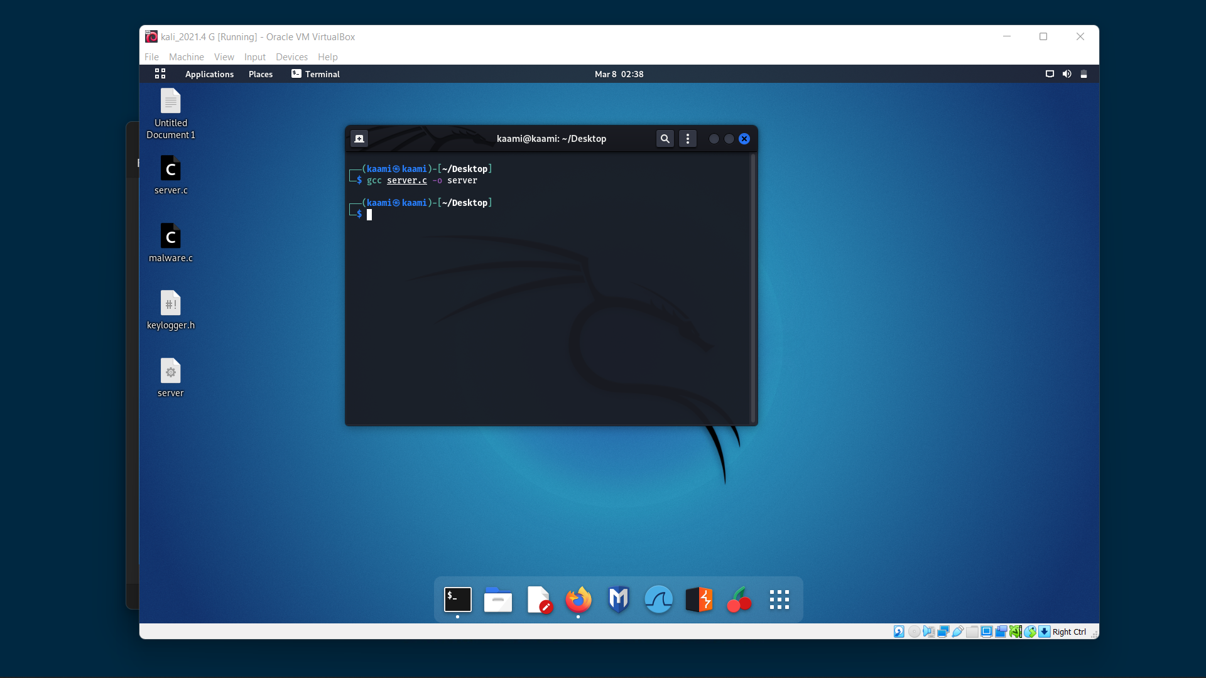

Slide 15


Slide 16
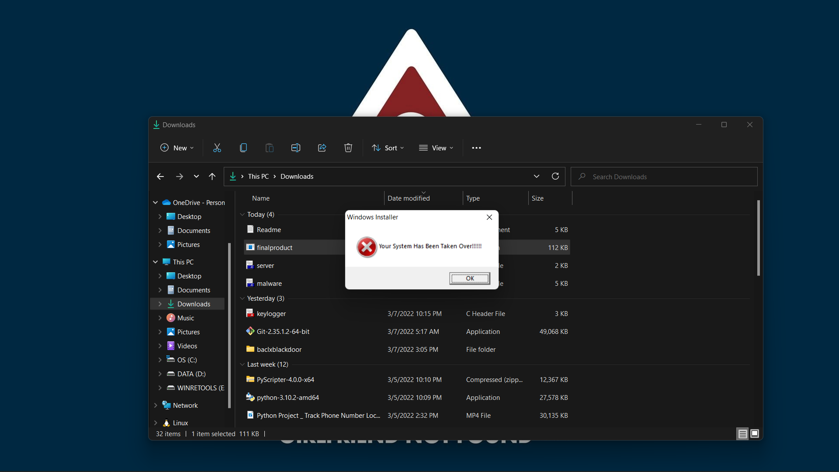

Slide 17


Slide 18
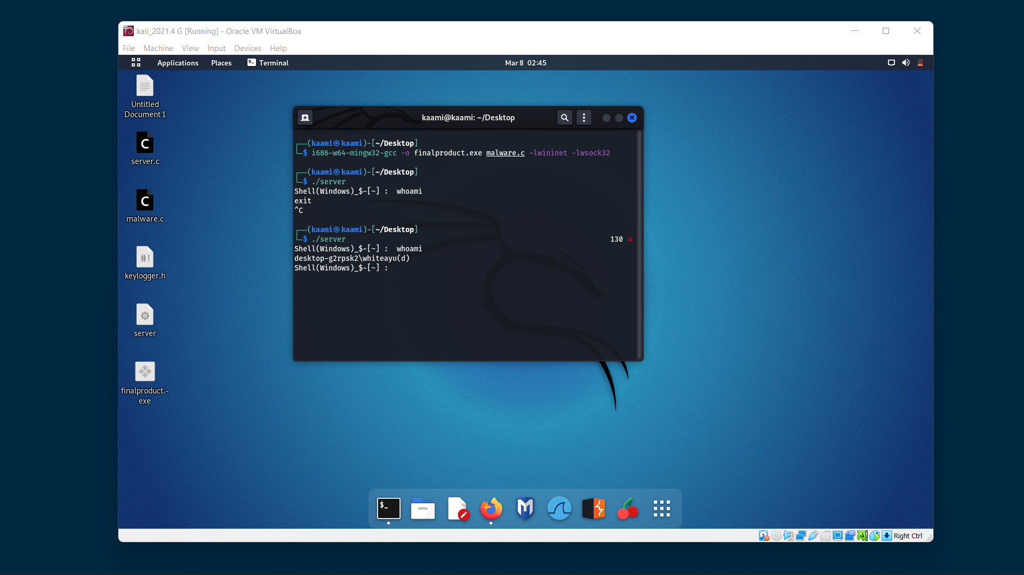

Slide 19
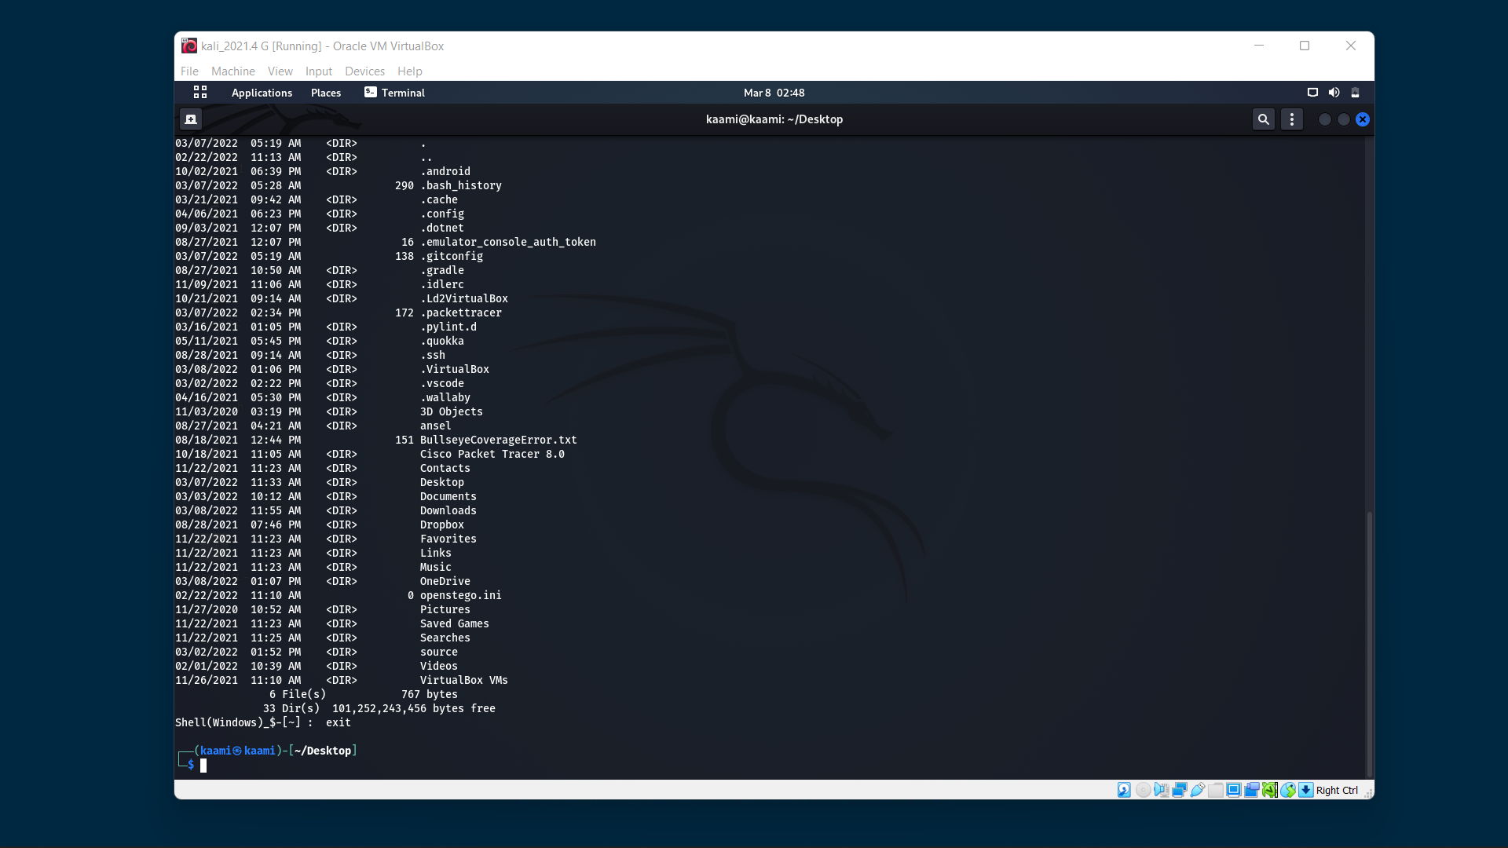

Slide 20
Conclusion
We get to know how a windows firewall works.
Got the knowledge of the color RBG and their manipulation.
Improved knowledge of Linux operating system and virtualization.
Get the knowledge about how to build a connection between the virtual machine and the windows environment.

Slide 21
Refrences
https://www.google.com/search?q=what+is+the+absolute+value+of+integers&rlz=1C1CHBF_enIN976IN976&oq=what+is+the+absolute+value+of+integer&aqs=chrome.0.0i512j69i57j0i22i30l8.64104j0j7&sourceid=chrome&ie=UTF-8
https://stackoverflow.com/questions/22604196/difference-between-return-1-return-0-return-1-and-exit
https://www.w3schools.com/html/html_css.asp
https://www.liquidweb.com/kb/windows-firewall-basics/#:~:text=Windows%20Firewall%20blocks%20all%20incoming,Firewall%20blocks%20all%20other%20traffic.
https://answers.unity.com/questions/128407/convert-rgb-to-decimal.html#:~:text=The%20equation%20is%20very%20basic,float%20to%20get%20decimal%20values.

Slide 22
https://www.serveradminz.com/blog/can-linux-server-communicated-windows-client/

Slide 23


